Slide 1
International
Credit Mobility Call for Proposals 2015
Notes:
KEY MESSAGES
HEIs are applying for sets of mobility flows with one or more partner countries. Eg Politecnico di Milano is applying for grants to work with HEIs in China, Ukraine, Morocco and Argentina.
Mobility can be incoming and also outgoing, staff as well as students at all levels- however we can expect more incoming than outgoing
The budget is divided into regional envelopes and some are much bigger than others, so it's worth checking with your NA, how much is available and tailoring your application.
Competition will be intense, so it's best to work with partners you already know, and if you are unsure of a partner, start with staff mobility before students.
The 4 evaluation criteria are common sense for European HEIs, based on their Charter and their internationalisation strategy. But work must be done to explain how Partners will recognise credits and benefit overall from the mobilities.

Slide 2
What is Erasmus+?
EU programme to support education, training youth & sport
Fosters EU-EU & EU-international cooperation

Slide 3
2007-2013
2014-2020
EU - EU
Erasmus
1 Learning Mobility
Leonardo
Grundtvig
Comenius
Erasmus+
2 Coop-eration
Youth in Action
Erasmus Mundus
Tempus
Edulink
Alfa
3 Policy support
Jean Monnet Sport
International
Notes:
Many of the projects funded during the 2007 – 2013 period offered mobility opportunities for students and staff and many still have ongoing projects
e.g.
Erasmus Mundus Action 2,
ICI-ECP,
Tempus, Alfa, Edulink,
Marie Curie,
Nationally funded bilateral mobility schemes with Partner Countries

Slide 4
Higher education
cooperation opportunities
Academic mobility
Jean Monnet Activities
Capacity Building for HE
Degree mobility
EMJMD
International credit mobility
Academic cooperation

Slide 5
International credit mobility?

Slide 6
What is international credit mobility?
International opening of Erasmus
135,000 grants over 6 years
For students & staff (for learning & teaching & training)
Action managed by National Agencies located in Programme Countries

Slide 7
Call 2015
Programme Countries | Partner Countries
28 EU Member States + 5 additional countries: Iceland, Liechtenstein, FYROM, Norway, Turkey. | Other countries except: Switzerland ACP countries Gulf Cooperation countries Iran, Iraq, Yemen
Notes:
ACP
Angola, Antigua and Barbuda, Belize, Cape Verde, Comoros, Bahamas, Barbados, Benin, Botswana, Burkina Faso, Burundi, Cameroon, Central African Republic, Chad, Congo (Brazzaville), Congo (Kinshasa), Cook Islands, Côte d'Ivoire,Djibouti, Dominica, Dominican Republic, Eritrea, Ethiopia, Fiji, Gabon, Gambia, Ghana, Grenada, Republic of Guinea, Guinea-Bissau, Equatorial Guinea, Guyana, Haiti, Jamaica, Kenya, Kiribati, Lesotho, Liberia, Madagascar, Malawi, Mali, Marshall Islands, Mauritania, Mauritius, Micronesia, Mozambique, Namibia, Nauru, Niger, Nigeria, Niue, Palau, Papua New Guinea, Rwanda, St. Kitts and Nevis, St. Lucia, St. Vincent and the Grenadines, Solomon Islands, Samoa, Sao Tome and Principe, Senegal, Seychelles, Sierra Leone, Somalia, Sudan, South Sudan, Suriname, Swaziland, Tanzania, East Timor, Togo, Tonga, Trinidad and Tobago, Tuvalu, Uganda, Vanuatu, Zambia, Zimbabwe.
Gulf Cooperation Countries
Bahrain, Kuwait, Oman, Qatar, Saudi Arabia, United Arab Emirates.
ACP countries will be included in future calls from 2016.
Iran, Irak Yemen will be eligible for Degree Mobility windows and Capacity Building, but never credit mobility
Gulf countries will have Degree Mobility windows but not credit mobility or Capacity Building.

Slide 8
Types and duration
All levels (short cycle, Bachelor, Master, PhD)
All disciplines
Students: 3 months (or academic term) to 12 months
Staff: 5 days to 2 months
Notes:
Up to 12 months per study cycle so a student can be funded for 12 months during Bachelors and an additional 12 months during Masters etc etc.

Slide 9
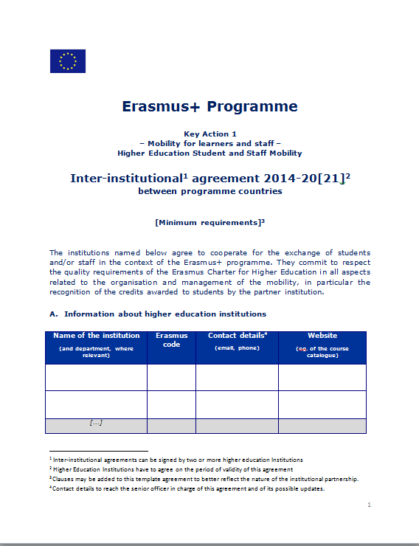
Mobility based on agreements
Inter-institutional agreements fix mobility flows & conditions - signed before mobility starts
ec.europa.eu/education/opportunities/higher-education/quality-framework_en.htm
Learning Agreement for students
Mobility Agreement for staff
Notes:
Credit mobility building upon previous experiences in:
Erasmus Mundus Action 2,
ICI-ECP,
Tempus, Alfa, Edulink,
Marie Curie,
Nationally funded bilateral mobility schemes with Partner Countries
Learning Agreement with students is explicit about language support offered by sending/receiving host

Slide 10
Managing mobility
European HEIs apply on behalf of the partnership to their National Agency
16 or 24 months to organise mobilities
Budget = Organisation support Living Allowance Travel
Notes:
Organisation Support = 350 EUR per participant
Living Allowance = monthly unit cost for students or daily unit cost for staff;
Travel = unit cost based on distance.
Programme Country beneficiaries will receive the entire budget and can make flexible arrangements with their Partner HEIs on how to manage the budget – this should be encoded in the IIA.

Slide 11
Student Unit
Costs
Group 1 higher living costs | DK, IE, FR, IT, AT, FI, SE, UK, LI, NO
Group 2 medium living costs | BE, CZ, DE, EL, ES, HR, CY, LU, NL, PO, SI, IS, TR
Group 3 lower living costs | BG, EE, LV, LT, HU, MT, PL, RO, SK, FYROM
Incoming to Prog. Countries €850, €800, €750
Outgoing from Prog. Countries €650

Slide 12
Staff Unit Costs
Host Country | Per Diem
DK, IE, NL, SE, UK | 160
BE, BG, CZ, EL, FR, IT, CY, LU, HU, AT, PL, RO, FI, IS, LI, NO, TR | 140
DE, ES, LV, MT, PO, SK, FYROM | 120
EE, HR, LT, SI | 100
Partner Countries | 160

Slide 13
Travel
Travel distances (km) | € / participant
100 - 499 | 180
500 - 1999 | 275
2000 - 2999 | 360
3000 - 3999 | 530
4000 - 7999 | 820
≥8000 | 1100

Slide 14
2015 call: €121.3m by region
Notes:
European Neighbourhood Instrument = ENI
Neighbourhood Eastern Partnership = Armenia, Azerbaijan, Belarus, Georgia, Moldova, Territory of Ukraine as recognised by international law
Neighbourhood South Mediterranean = Algeria, Egypt, Israel, Jordan, Lebanon, Libya, Morocco, Palestine, Syria, Tunisia
Russian Federation = Territory of Russia as recognised by international law
Development Co-operation Instrument = DCI
Latin America = Argentina, Bolivia, Brazil, Chile, Colombia, Costa Rica, Cuba, Ecuador, El Salvador, Guatemala, Honduras, Mexico, Nicaragua, Panama, Paraguay, Peru, Uruguay, Venezuela
Asia = Afghanistan, Bangladesh, Bhutan, Cambodia, China, DPR Korea, India, Indonesia, Laos, Malaysia, Maldives, Mongolia, Myanmar, Nepal, Pakistan, Philippines, Sri Lanka, Thailand and Vietnam
Central Asia = Kazakhstan, Kyrgyzstan, Tajikistan, Turkmenistan, Uzbekistan
South Africa
Instrument for Pre-Accession =IPA
Western Balkans = Albania, Bosnia and Herzegovina, Kosovo, Montenegro, Serbia
Partnership Instrument = PI
North America = Canada, United States of America
Industrialised Asia = Australia, Brunei, Hong Kong, Japan, (Republic of) Korea, Macao, New Zealand, Singapore, Taiwan

Slide 15
€121.3m = 20,000 mobilities
Notes:
20,000 mobbilities divided by the 33 National Agencies
Each NA will publish how much budget they have for each of the 10 envelopes and whether there are any restrictions attached to these budgets.

Slide 16
How to apply
Deadline: 4 March 2015
Partner Countries: discuss inter institutional agreements with Programme Country partners
Read the Guide for Experts
ec.europa.eu/programmes/erasmus-plus/discover/guide/documents/expert-guide_en.pdf
Application form ec.europa.eu/programmes/erasmus-plus/documents/form/mobility-programme-partner-countries_en.pdf
Notes:
The Guide for Experts gives more details about what the evaluators are expecting to for each of the 4 award criteria and it is crucial to have read and understood this document before preparing an application.

Slide 17
Application form:
qualitative assessment
Relevance of mobility project
Internationalisation strategy
Types of mobility
Quality of cooperation
Previous experience
Definition of responsibilities & tasks
Quality of project design & implementation
Selection, support and recognition
Impact & dissemination
Impact on different levels
Dissemination measures
Notes:
Indicate the specific partner HEIs and explain the benefit to both Programme and Partner Country institutions
Not useful to apply for mobility with every country imaginable – they will have to demonstrate the relevance
If newcomers: start with staff mobility. For more "complicated" exchanges that require recognition, we advise to build on previous experience, knowing the partners
Secondary criteria
24 months recommended
Be precise in your quality questions!

Slide 18
More information
Information on Erasmus+
ec.europa.eu/programmes/erasmus-plus/
National Agencies
ec.europa.eu/programmes/erasmus-plus/tools/national-agencies/

